Slide 1

Predicting the path of COVID19
IST 718 Team Various Corn:
Beau Chapman
Alex Manso
Maya Mileva
Jason Nguyen
Nicole Villanueva
Notes:
Beau: Title page to Specification (Slide 1 - Slide 8)
Alex: Analysis dashboard, commandeer the presentation (Slide 9)
Maya/Nicole: Talk about respective model (Talk about the models (Slides 10 - Slide 11)
Jason: Talk about respective model, recommendations and caveats (Slide 11 - Slide 17)

Slide 2

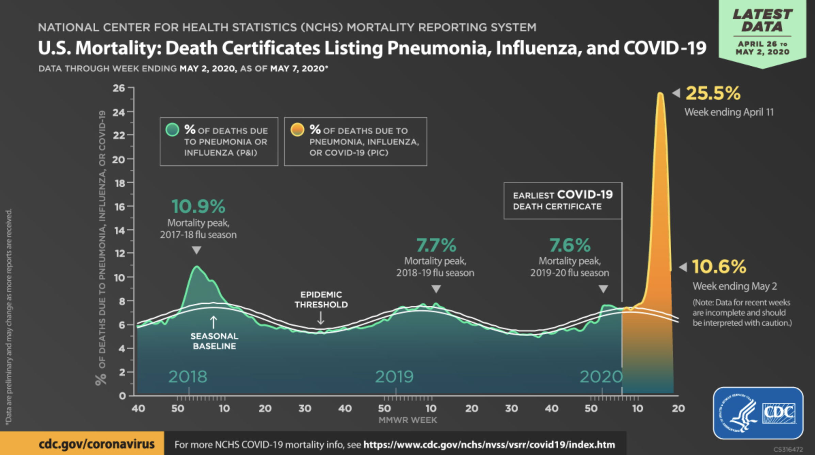
Background

Slide 3
Summary
Around late February a novel virus caused by SARS-CoV-2 named COVID-19 (Coronavirus) began sweeping rapidly through the United States. Various institutions began collecting data on the infection rate, confirmed cases and rate of death in an attempt to measure the impact of this ongoing pandemic.
Our findings include:
-Not all models are effective for making predictions on COVID, Certain states showing increased rates would require more resources, exploratory analysis is powerful
As a result, our recommendation is:
-Social distancing is effective, the threat of the virus isn’t likely to go away any time soon so be careful about immediately returning to normalcy, be wary of unpredictable events and forecasts are only as good as the data source

Slide 4
Specification - The Problem & Goal
The goal of this report includes:
Trying to predict (i.e. drop/increase/flatten) and forecast US COVID-19 cases on a national level and by state.
Forecasting confirmed cases will help inform public health decision-making by projecting the likely impact in coming weeks.
Predicting the directional and magnitudinal outcomes for if we decide to re-open businesses now (e.g. Increase, decrease, or flat rate of infection/death)
Directly comparing states that have implemented different responses to COVID-19 (Still closed, reopening for business, wearing masks)

Slide 5
Specification - The Data
This report includes referencing two important sources for our data:
John Hopkins Data -
The data shows patterns of infection rates, infection rates per capita all over a time series
We can get a sense of the severity of COVID infection rates from this data over time
Initial John Hopkins data is cleaned and formatted to better suit our purposes as the core data
COVID19 Mobility Reports -
Aggregated, anonymized insights from Google Maps and other Google products.
Shows changes in movement trends over time by geography across categories of places (i.e., retail, groceries/pharmacies, parks, transit stations, workplaces, and residential)
Overall aggregated death/infection rates, lat/long of cases

Slide 6
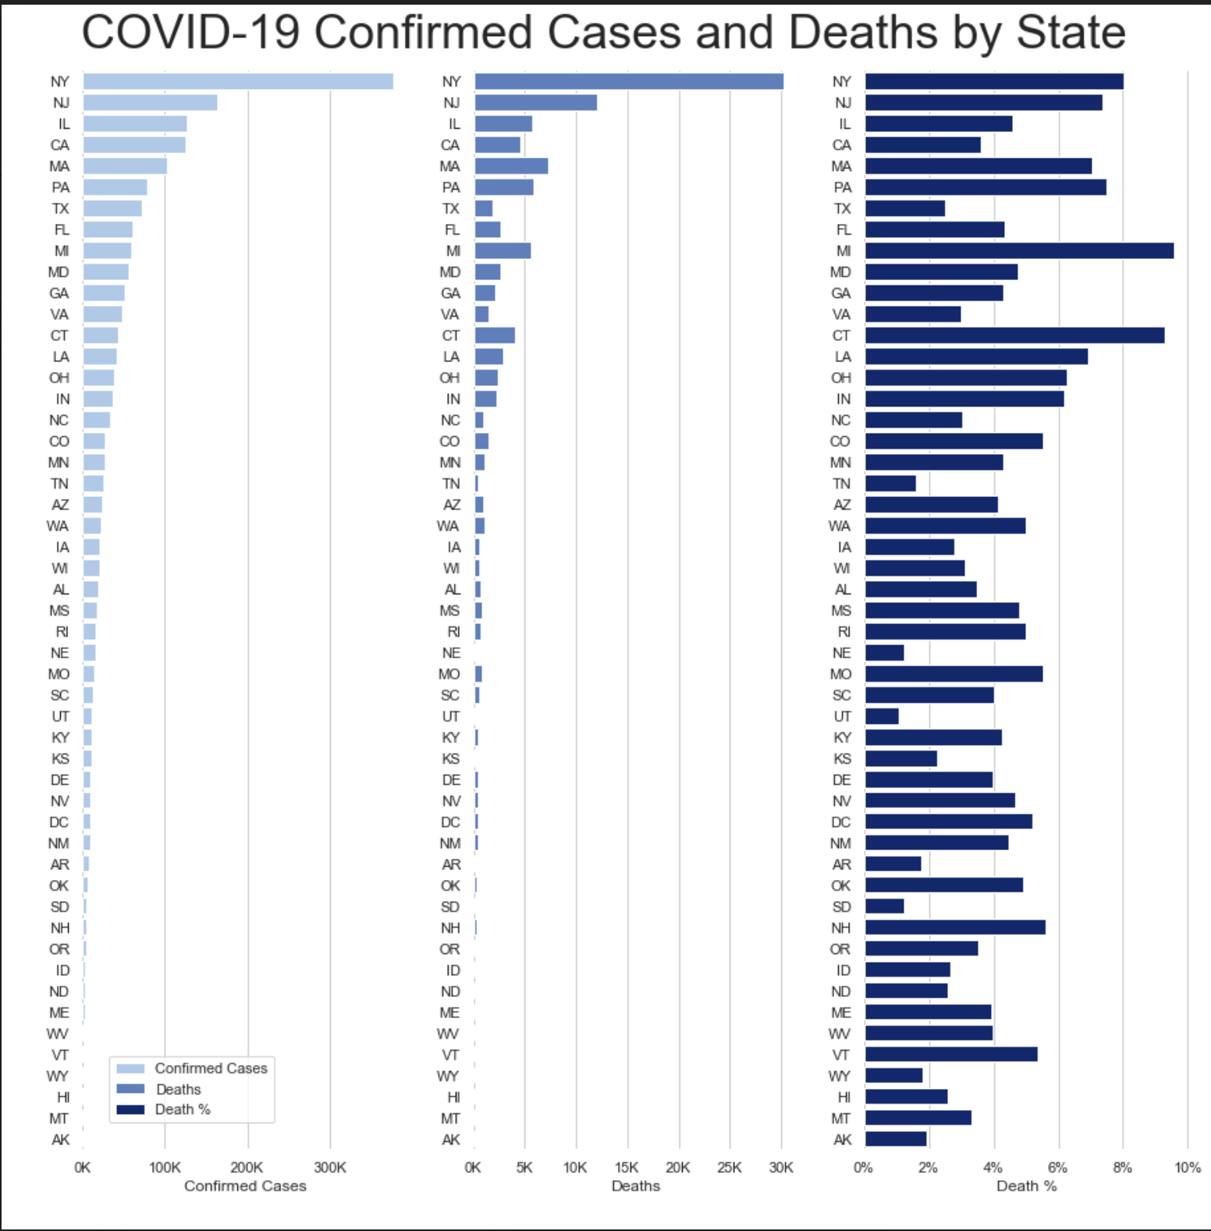
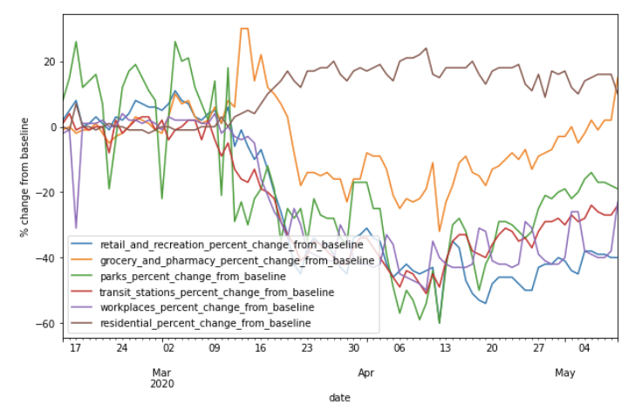
Specification - Visualizing the data
John Hopkins data visualized
Google COVID mobility report visualized

Slide 7
Observation - Exploring the dataset
Live Demo: COVID-19 Dashboard
https://covid-dash-manso.herokuapp.com/

Slide 8
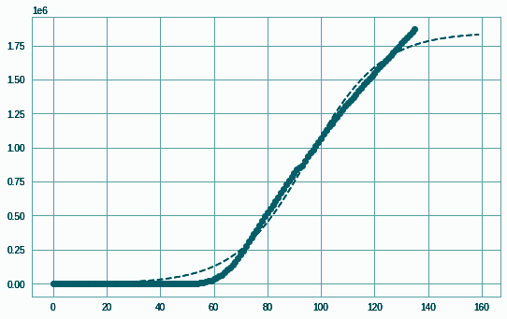
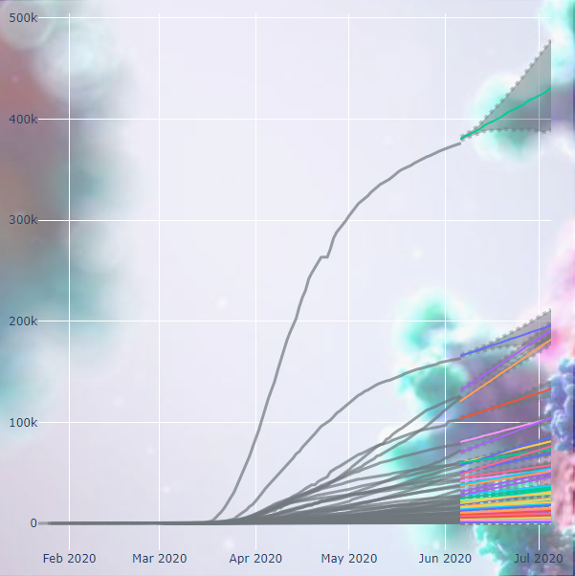
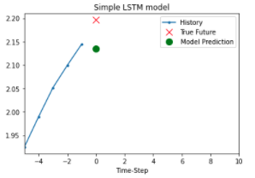
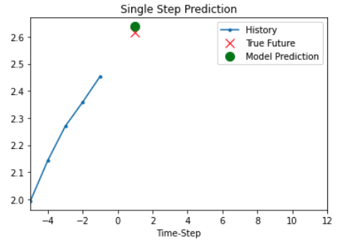
Analysis - Models
Logistic Curve USA
Time series forecast (ARIMA, Prophet)
Neural Network on different states (by population, unemployment rates, median income, etc.)
Multivariate Logistic Curve / Linear Regression
Population density, unemployment, & median income
Prophet
Long Short Term Memory NN
Multivariate Single Step Model
Notes:
Time series: @maya
Neural Networks: @nicole
Linear Regress: @Jason

Slide 9
Analysis - Model Evaluation
Feature | Prophet | ARIMA | Neural Network
Accuracy of prediction | RMSE (total US): Mean: 1845 cases Median: 923 cases State base: RMSE increase with the horizon | RMSE (all states): Mean: 772 cases Median: 361 cases | Multivariate single-step model had accurate predictions when tuned to a particular state, but this did not scale well in a function modeling all 50 states.
Compute time | 250 seconds in total | 300 seconds in total | ~10 - 120 seconds per state
Effort of labor | Easiest to work with, blessed be upon the Prophet | Difficult, a lot of overhead in building the model | High effort, very complex (worse than lab 6)
Flexibility of model tuning | Inflexible to build, easy to work with, fast | Requires more attention, ARIMA parameters have to be tuned | Requires fine-tuning for every parameter

Slide 10
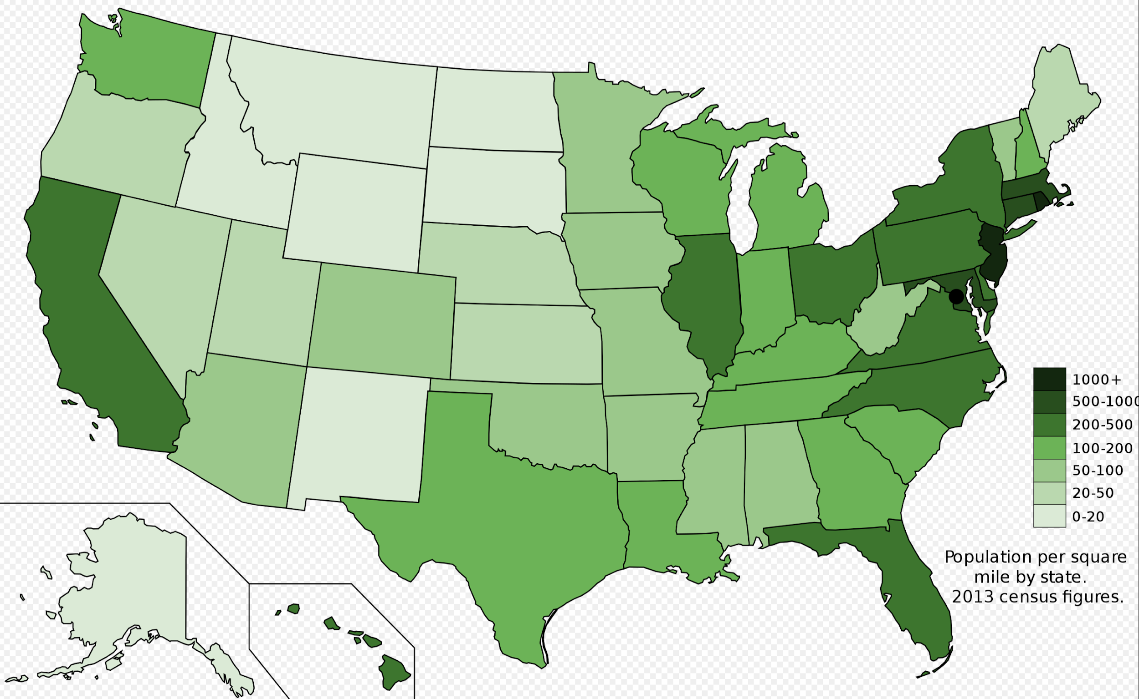
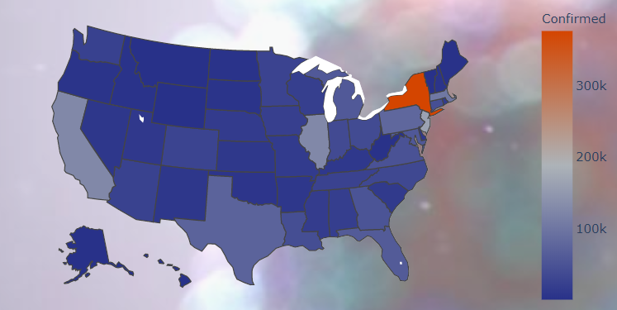
Recommendation 1
Social distancing is an effective countermeasure to a degree, densely populated states may lack an inherent ability to socially distance.
The US map colored in green represents ‘population density by state’
Compare our map of reported confirmed cases by state shown directly beneath

Slide 11
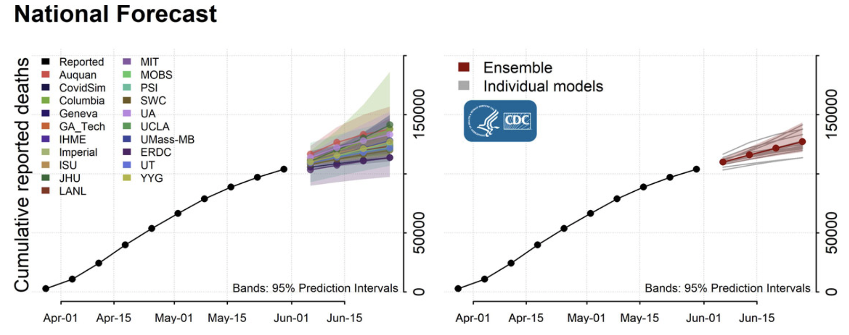
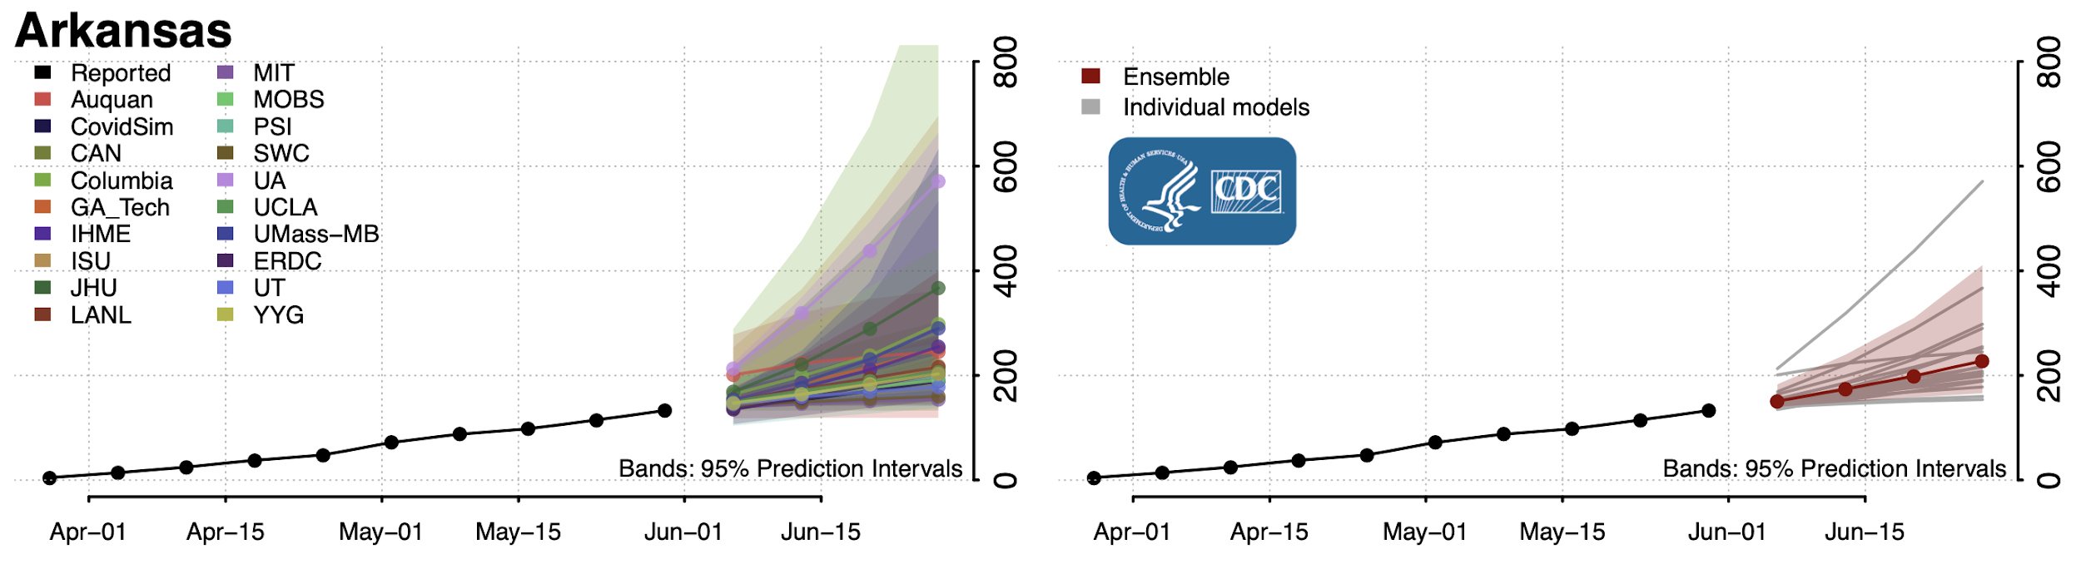
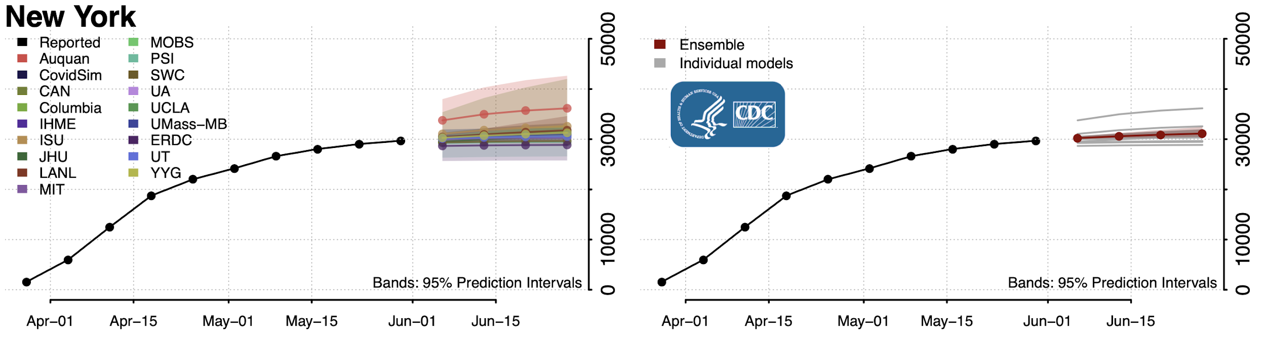
Recommendation 2
This virus will likely remain prevalent for the rest of the year based on model forecasting, the early arrival of a vaccine could upend this prediction
Be wary of calls for an immediate returning to normalcy
Some states are predicted to fare better than others...

Slide 12
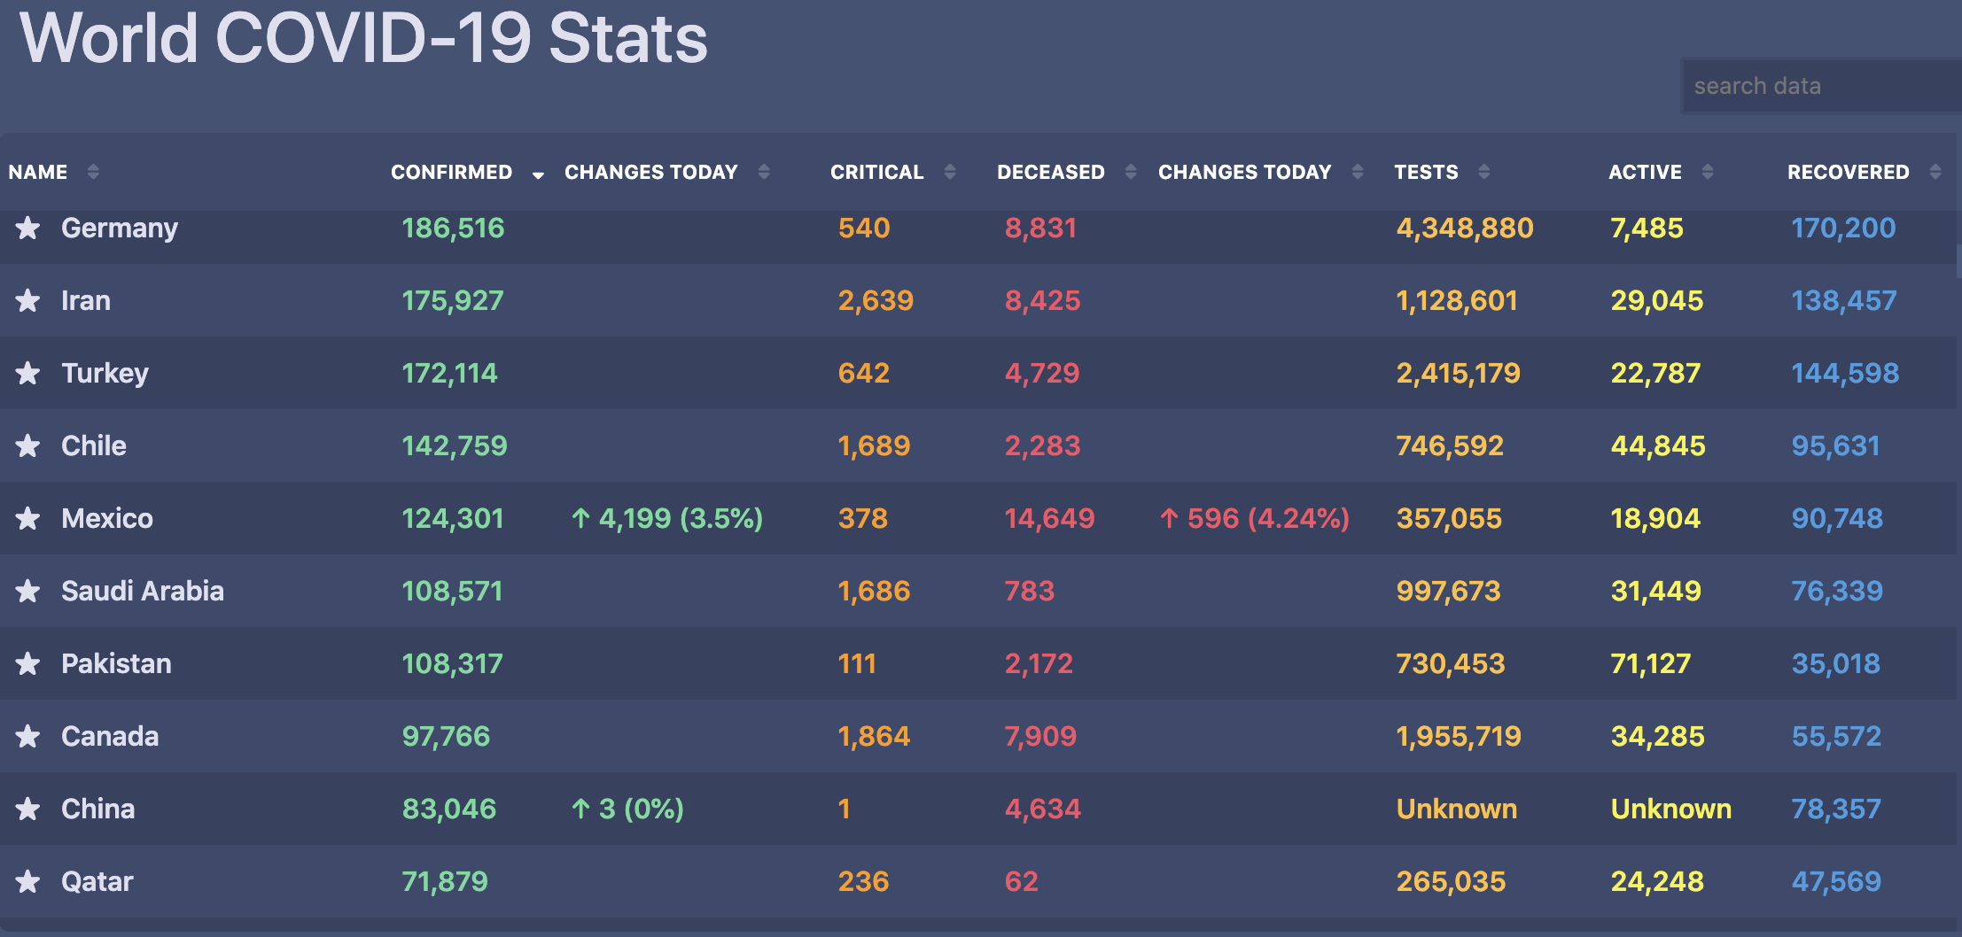
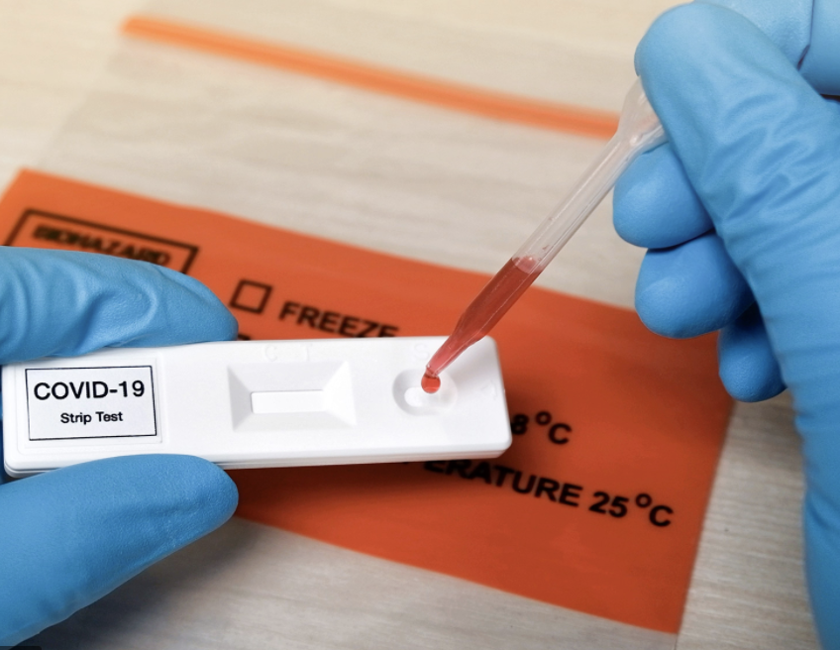

Caveats, shortcomings and areas to improve
Our predictions can only be as good as our dataset. Before our team settled on a single primary source for our base data, we evaluated 10+ sources.
Data may be incorrectly reported and is constantly changing. Having more time to track this would have been great.
Antibody test and relapse FP’s; social pressure
Notes:
-On a global level it’s hard to trust some reported data
-We should be skeptical even about the data that’s reported by different states within the US

Slide 13
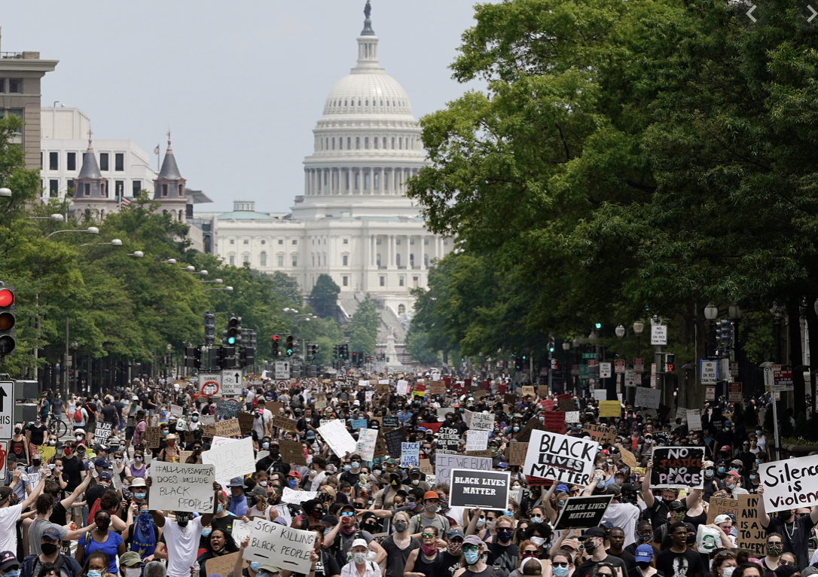
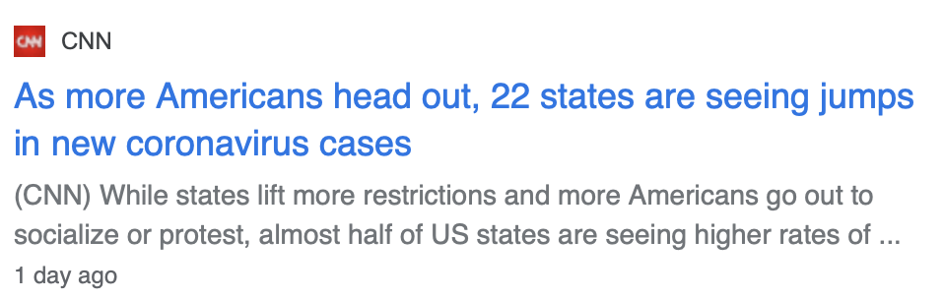
Caveats, shortcomings and areas to improve
Predicting future events w/ just ‘reported data’ can’t tell us everything, recent events that can’t be represented in data (i.e. civil unrest) instinctively leads us to predict another spike in cases.
JHU data is based on reported confirmed cases from the CDC and not when someone feels sick or tests positive at their local doctor
Caused values to lag drastically in March
Reported values from the previous 3-7 days are incompletely

Slide 14
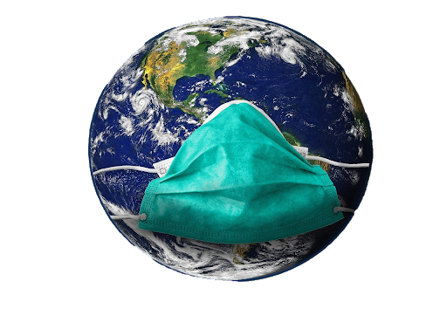

END
STAY SAFE!

Slide 15
References
https://github.com/CSSEGISandData/COVID-19/tree/master/csse_covid_19_data
https://public.flourish.studio/story/337752/
https://www.google.com/covid19/mobility/
https://colab.research.google.com/drive/1wabD0uZmseo84UZ6pgQhYBrNUdu6gt5Y?usp=sharing
https://www.kaggle.com/sudalairajkumar/novel-corona-virus-2019-dataset#time_series_covid_19_confirmed_US.csv
https://www.cdc.gov/coronavirus/2019-nCoV/index.html
https://www.tensorflow.org/tutorials/structured_data/time_series#baseline
https://dash.plotly.com/
https://colab.research.google.com/drive/1kAsNPoeLJWD6369H4DQkqS62CXoArXbb?usp=sharing
Washington State Department of Health Data Science Team
Resources for those directly affected by COVID19
Resources for if you or someone you know is sick
Handy dashboard for helping you stay informed on COVID spread

Slide 16
Appendix
Neural Networks
Analysis and Modeling

